Slide 1


GitHub for Fisheries Scientists
UAF AFS Student Subunit
March 18, 2021
Justin Priest
https://github.com/justinpriest/github_demo_afs

Slide 2

Justin Priest
2020 CFOS Graduate from
Dr. Trent Sutton’s Lab
ADF&G Coho Salmon Researcher in Sitka & Juneau
Learned R tools at CFOS (easy way) & taught myself (hard but fun way)

Slide 3
Overview
1 – What is GitHub
2 – But why?
3 – How can I use GitHub
4 – Show me the demo!
5 – Cool! What’s next?!
Notes:
These first two sections will hopefully convince you of the benefits of GitHub, the next two will demonstrate the installation process and basic usage, and the last section will leave you with some resources to

Slide 4
1 – What is GitHub?

Slide 5

1 – What is GitHub?
Git is the underlying tech
Integrates a version control program into other programs
Backend (behind the scenes)
GitHub is a specific site
Other sites too (e.g., GitLab and BitBucket)
Front end (website interface)

Slide 6

1 – What is GitHub?
GitHub is a website that syncs with software on your computer to upload your files to github.com

Slide 7
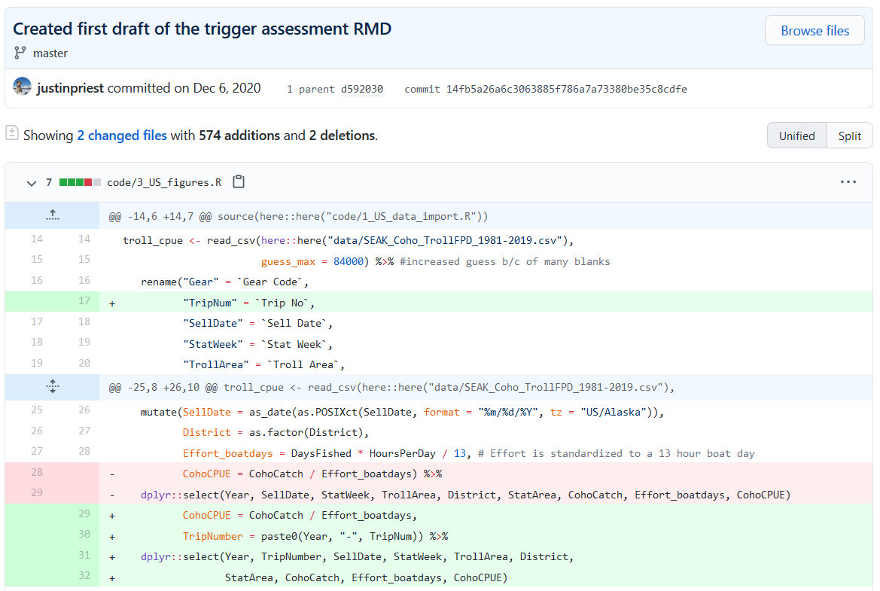
1 – What is GitHub?
Git is versioning control software
This means we can keep track of new additions (in green) and deletions (in red)
Later, we’ll cover more about benefits

Slide 8

But Why?

Slide 9
2 – Why Use GitHub??
Change is haaaaard

Slide 10
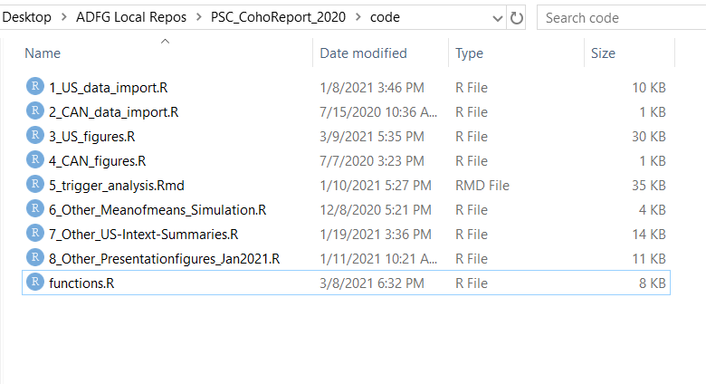
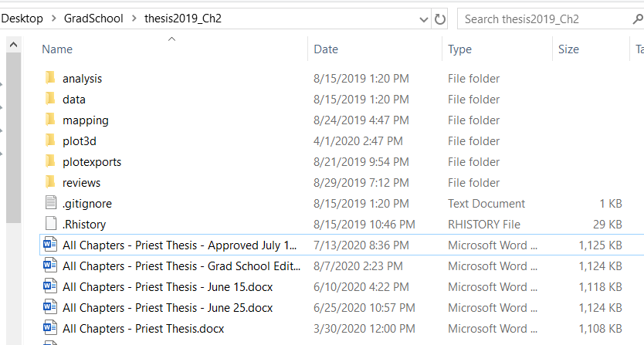
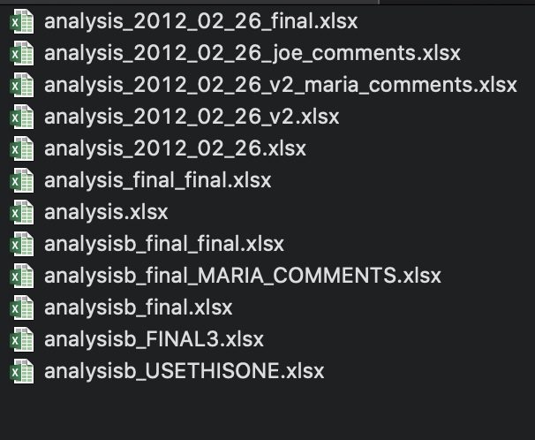

2 – Why use GitHub: Version Control
Versioning: The bane of digital file storage
Enter Version Control!
credit: Julie Lowndes & Allison Horst

Slide 11




2 – Why use GitHub
GitHub helps scientists with:
Code sharing
Version control helper
R file
R file
R file
V1
R file
V2
R file
V3
V9
Project & data analysis storage

Slide 12
2 – Why use GitHub
As scientists, we can use GitHub over a project’s lifecycle:
Archive final data
Record analysis versions
Back up our analysis files
Collaborate with coauthors
Show results to others
Share analysis when we publish!

Slide 13


Slide 14
2 – Why Use GitHub: Use Case
Kyle is a grad student that stores his R thesis files locally. He has the following problems:
Requires backing up files
Has multiple versions of same file
Little record of previous versions
Emails files to collaborators
When publishing, usually does not include his code (“Trust me, bro!”)
Carolyn is a grad student that uses GitHub for her thesis. She encounters the following:
Stores files in cloud easily
Has no version issues
Record of all changes to analysis
Collaborates with just a few clicks
When publishing, sends editors and reviewers her code link (“I trust her, bro!”)

Slide 15
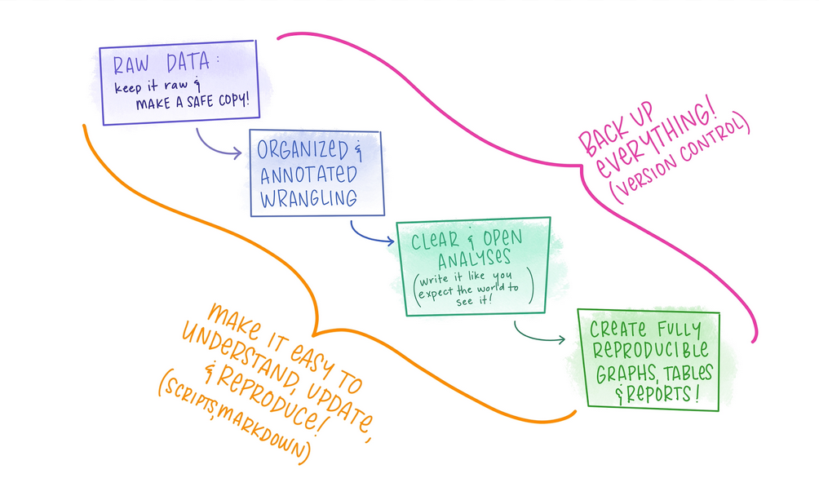
Figure: Allison Horst
Notes:
As shown in that example, Carolyn used the tools to make her life easier!
Put another way, our goals are to create analysis that is easy to understand & reproduce. For our own sanity, we would like to make sure that we don’t have 1000 versions of everything.

Slide 16
3 – How Can I Use GitHub
One time setup & Daily usage

Slide 17
3 – A bit of Jargon
repo (repository)
remote
local
clone
=
=
=
=
A “folder” containing an individual project
The repo on github.com
The repo on your computer
Copy the remote repo to your computer

Slide 18


3 – A bit of Jargon
Local
Repo
Remote
Clone

Slide 19
3 – How can I use GitHub
One Time Setup, part 1
Get a free account from github.com
GitHub has great benefits for their student accounts!
Download & install the program “git”
Note the folder where this installs. In Windows common places are C:\Users\jtpriest\AppData\Local\Programs\Git (change to your username) C:\Program Files\Git
Accept all default settings and click through until installed.
Notes:
We won’t spend too long on this part because hopefully you did this ahead of time! If you followed all directions and still can’t get it figured out, email me after class

Slide 20
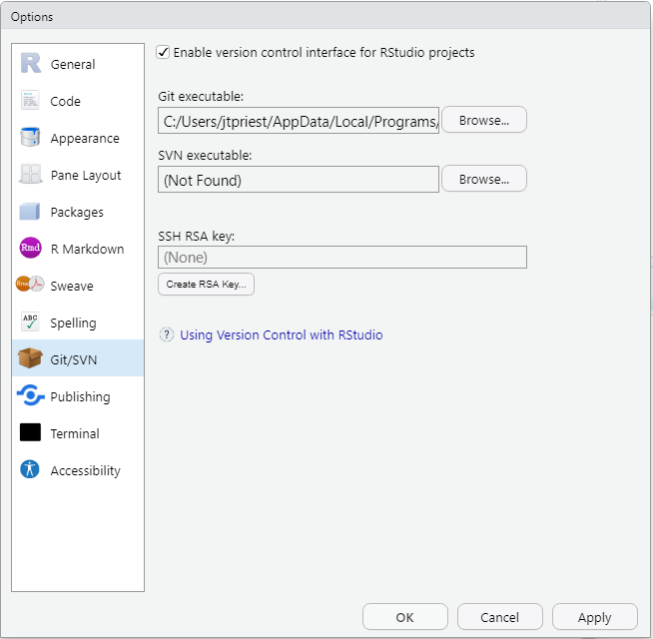
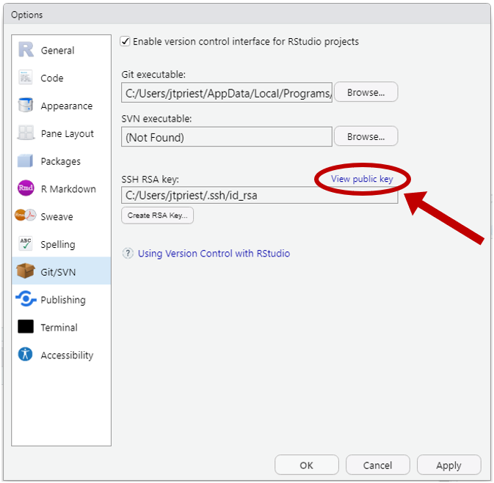
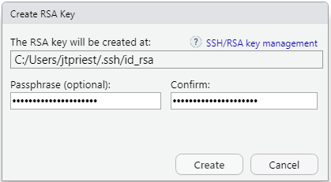
3 – How can I use GitHub
One Time Setup, part 2
In RStudio, under Tools, -> Global Options ->“Git/SVN”
In the window that pops up, select “Enable version control interface for RStudio projects”.
Under “Git executable” click browse and select the correct folder noted before. Select the git.exe file, typically found in folder “bin”.
Next click “Create RSA Key”. Note folder location. Give it a memorable password, then click Create. Once it is done, you’ll see some random art and file info. Click Close.
Now you’ll want to open up and view this key. Click the small blue “View public key”. At this point you’ll see some random text that starts with “ssh-rsa”. Copy this!
Open up github.com and go to your profile settings
Click on “SSH and GPG keys” on the left. Click the green “New SSH key” button. Paste the key from RStudio in the key section. Give this key a unique title describing which computer you’re using.
Notes:
(This is where it can be helpful to have Windows show you file extensions).
(What we’re doing here is a creating a “key” that will allow RStudio to know that this computer is definitely you!)

Slide 21
3 – How can I use GitHub
One Time Setup, part 3
In RStudio, install and load package “usethis”. Run this code
library(usethis)
use_git_config(user.name = “Your Name”, user.email = “your_email@alaska.edu”)
git_sitrep() # This shows current name, directory, and other settings
Yes, you do have to change these!
Notes:
Keep the quotes

Slide 22
3 – How can I use GitHub
Setup complete!
Only a little painful and you’ll never have to do that again!

Slide 23
3 – How can I use GitHub
How to set up a new project to work in
Step 1 – Create/choose repo on github.com
Project already exists on GitHub (“clone” it to your computer)
Go to repo webpage on GitHub and copy entire URL at the top (e.g., https://github.com/commfish/Chilkat_Sockeye)
Project will be new
While logged in, click green “New” repo button or go to https://github.com/new
Give it a name, chose public/private, add readme, (optional license & gitignore)
Copy entire URL at top

Slide 24
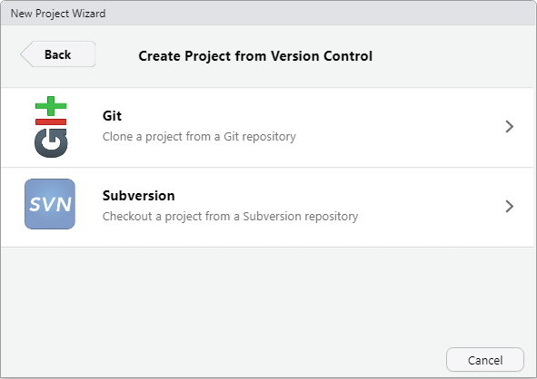
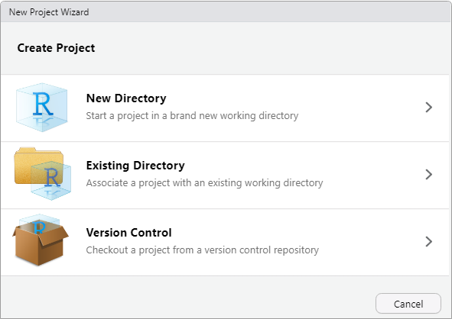
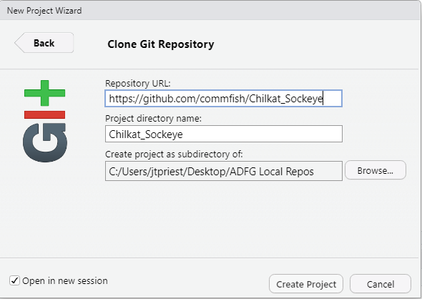
3 – How can I use GitHub
How to set up a new project to work in
Step 2 – Connect RStudio Rproject to the repo
Open RStudio. Click File -> New Project -> Version Control -> Git. Paste in the github.com address into the Repository URL (https://github.com/commfish/Chilkat_Sockeye)
It auto fills Project Directory Name (this will be local folder name; change if you like). Set the directory where this folder will be. Open in a new RStudio session (or not).
Click Create Project and all files on GitHub repo will sync. If large project, might take a few min.

Slide 25
3 – How can I use GitHub
Woohoo! So let’s review. We have:
Created a GitHub account
Connected our RStudio to this GitHub account
Synced an RProject with a github.com repo
This is huge! Now onto daily usage

Slide 26
3 – A bit (more) Jargon
Pull
Commit
Push
=
=
=
Download the latest changes from github.com
Prepping your changes for upload
Upload commits to github.com

Slide 27

3 – A bit (more) Jargon
Commit
Prepping your changes for upload
Pull
Push
Download changes from github.com
Upload commits to github.com
Perform them in this order!
Notes:
This might not make a lot of sense quite yet, but we’ll walk through it!

Slide 28
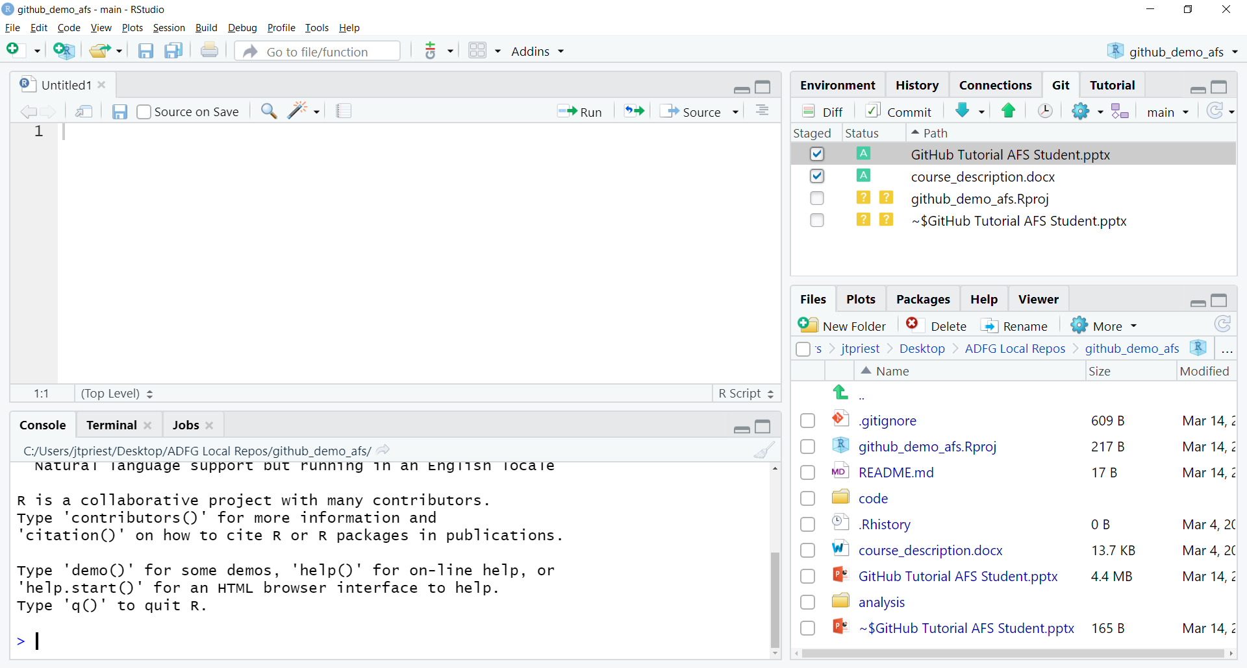

Slide 29
Box Color Meaning
?
Untracked
Modified
Added
Renamed
Deleted
M
A
R
D

Slide 30
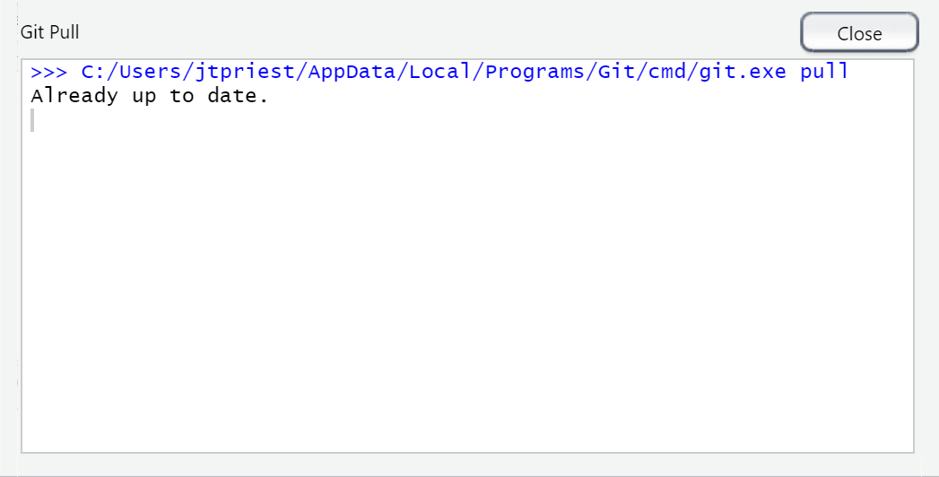
Pull First!

Slide 31
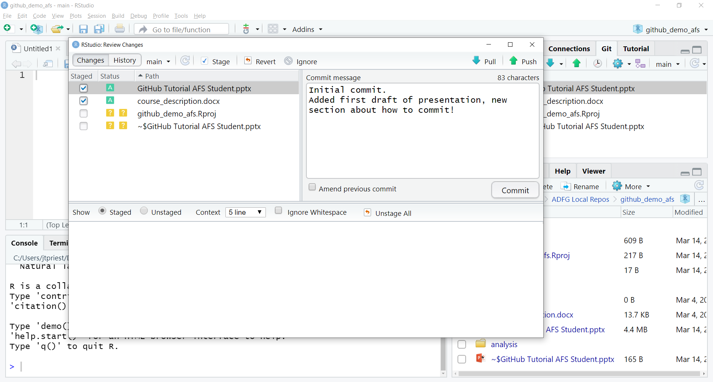
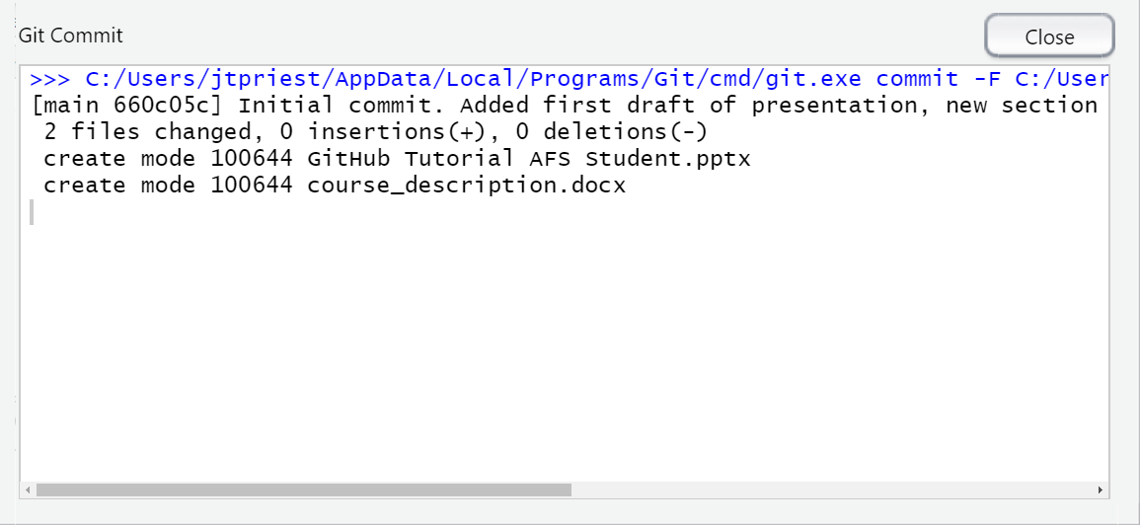
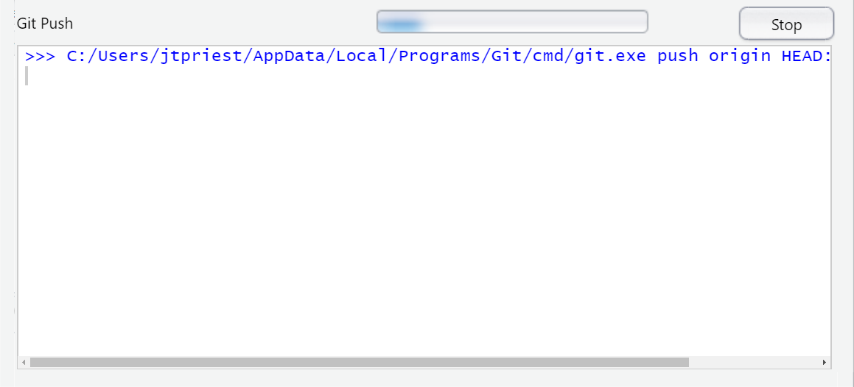
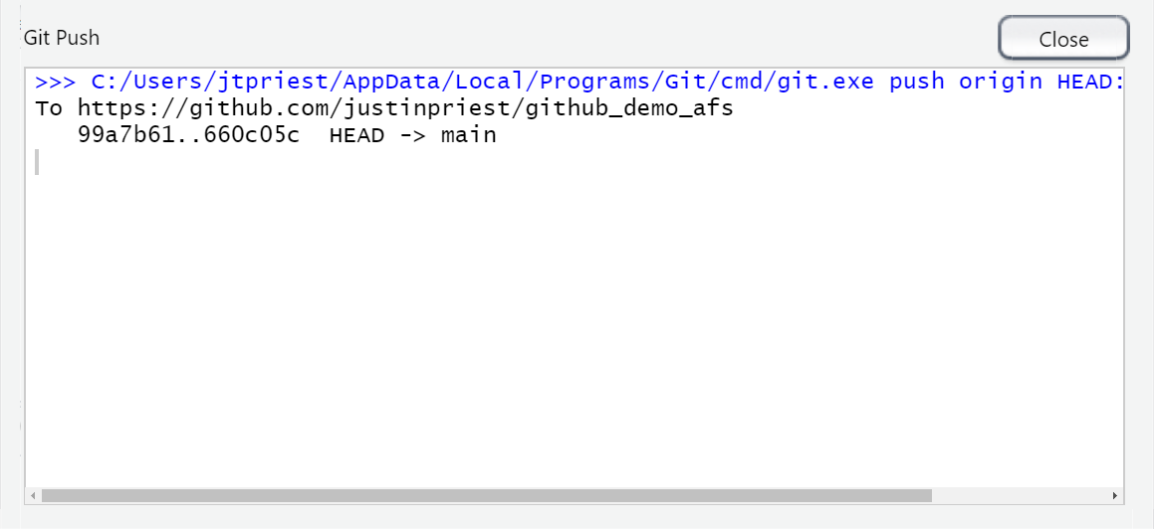
Success!

Slide 32
3 – How can I use R
Commit message
Added text (green)
Deleted text (red)
Notes:
Remember this?

Slide 33
4 – Show Me the Demo!

Slide 34
4 – Demo 1: Creating a repo
1
Follow along as I share my screen

Slide 35
4 – Demo 2: Cloning an existing repo
2
Follow along as I share my screen

Slide 36
4 – Demo 3: Collaboration!
3
Follow along as I share my screen

Slide 37
5 – Cool! What’s Next?!

Slide 38
5 – Cool! What’s Next?!
This just barely showed the capabilities of GitHub. You can
Use “Issues” to track, discuss, assign, and tackle remaining issues/tasks
Build a personal website
Build and store an R package
Follow / learn others’ code
Add a “branch” to explore test features without modifying the main data analysis
Follow and read the websites on next few slides to learn more

Slide 39
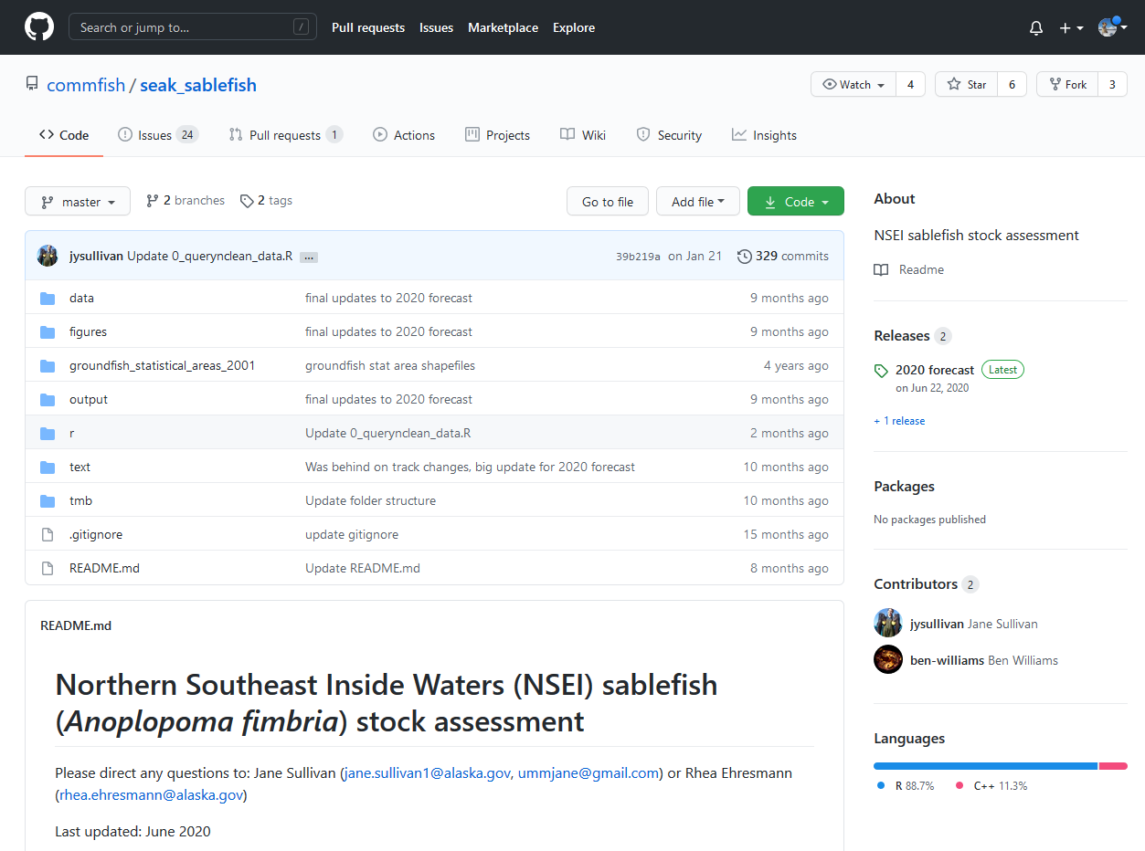
5 – Demo of Capabilities
One more
demo
https://github.com/commfish/seak_sablefish

Slide 40

5 – Last Thoughts
Git works best with “raw” or script-based files: R scripts, RMD presentations, CSV files, etc.
It works OK with MS Word, PowerPoint, .XLSX files, but more difficult to compare changes
Takeaway: If you can, use CSV files!
VS
X
.XLSX

Slide 41

Remember!
Pull -> Do your work -> Pull -> Commit -> Push

Slide 42
5 – Troubleshooting
What if I have an existing RProject that I want to push to GitHub?
Technically is possibly to push an existing RProject to GitHub, but it gets tricky (requiring command line git). It is simplest to create the new RProject, copy over files, and delete the old project.
I can’t push to GitHub!
Pull first. A collaborator probably made edits to the remote (GitHub.com) version and you need to grab that before you make any edits
How do I add a collaborator?
Go to the repo page on github.com and click settings -> Manage Access. Now they can push code to this same repo! Remember to work in the file separately and push/pull often!!

Slide 43

5 – Resources
Help I messed up!
ohshitgit.com (dangitgit.com)
I want to learn more!
An excellent quickstart guide
On Twitter, follow #RStats & @WeAreRLadies
See next slide!
My thesis burned my eyes, show me kittens
I got you! Browse away
?

Slide 44



The Real MVPs
Julie Lowndes & Allison Horst
R for Excel Users
Jenny Bryan
Happy Git With R
Alexa Thurston
GitHub for Advanced Ecological Data Analysis
Notes:
I of course did not know all these things and have learned them from SO MANY people. Folks with amazing resources that guided this presentation are the following

Slide 45



Questions? Contact me!
github.com/justinpriest
justin.priest@alaska.gov
twitter.com/justintpriest

